Slide 1
Using technology for maths teaching and learning: Instructional design, digital books and automated feedback
Dr. Christian Bokhove
University of Southampton
United Kingdom
Notes:
Abstract
: In this talk I will give an overview of research on the affordances of using technology in
teaching and learning mathematics. In particular I will:
•
Give an overview of specific affordances of technology and its role in instructional designs
for teaching and learning maths.
•
Describe how technology is more and more integrated in instructional materials, allowing
for digital maths books. I will show what affordances technology can have in the design of
these books, through examples from the MC-squared and enGasia projects.
•
Emphasise some features of these digital maths books, for example the feature to provide
customised automatic feedback, check geometric constructions and store student data.
Attendees can bring their own technology to try out some of the software.

Slide 2
Overview
Technology in general
Technology in maths
Features for maths technology
Instructional design, feedback, gamification
Integrated design: digital books
Some projects
Future developments
I will discuss these elements by frequently referring to own projects and research of the last decade. Sometimes I will demo some features in real time (see yellow vertical bars).
If you have any questions during the talk, ask!!
Note that during the plenary I did not cover all these slides (37-51). Nevertheless I left them in because they might be useful.

Slide 3
Who am I
Dr. Christian Bokhove
From 1998-2012 teacher maths, computer science, head of ICT secondary school Netherlands
National projects Maths & ICT at Freudenthal Instituut, Utrecht University
PhD ‘Use of ICT for acquiring, practicing and assessing algebraic expertise’ with Prof. Van Maanen and Prof. Drijvers
Lecturer at University of Southampton
Maths education
Technology use
Large-scale assessment

Slide 4
Maths education and technology
OECD report
Ma overview
http://www.keepeek.com/Digital-Asset-Management/oecd/education/students-computers-and-learning_9789264239555-en#.V8wy2jV5-aU

Slide 5
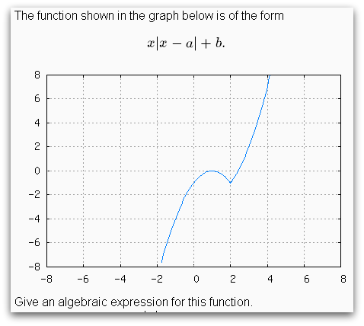
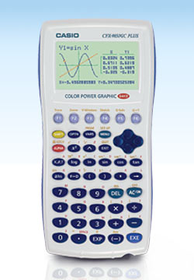
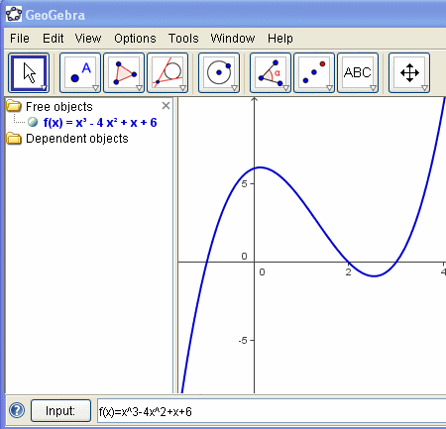
Maths education and technology
17th ICMI study “Mathematics Education and Technology-Rethinking the Terrain”
22nd ICMI study “Task Design In Mathematics Education”
…

Slide 6
Some aspects from own research
Predictors
No predictors
Gender
ICT knowledge
More time spent on whole module
More time spent at home or at school
Pre-knowledge
Relatively more time spent on non diagnos- tic parts
Attitude towards maths
Bokhove, C., & Drijvers, P. (2012). Effects of a digital intervention on the development of algebraic expertise. Computers & Education, 58(1), 197-208. http://dx.doi.org/10.1016/j.compedu.2011.08.010

Slide 7
…So need to check under what conditions it does work
Which is basically what I’ve done since 1998…in Wisweb, WELP, Galois, Sage projects. Participation in Activemath.
2007-2011
2004-2007
From 1998
2013-2016
2014-2017

Slide 8
Could be characterized as
From distinct, separate tools to integrated
From offline towards online
From not storing data to storing data
So not only is it important to know under what conditions technology works, but also what features might be potentially beneficial.

Slide 9
Software characteristics
Results externally validated instrument.
Eerst formulate what we need, then look for software.
Selected criteria:
Storage of student results;
In-between steps when solving equations;
Authoring;
Intuitive user interface;
60+ tools tried and evaluated;

Slide 10
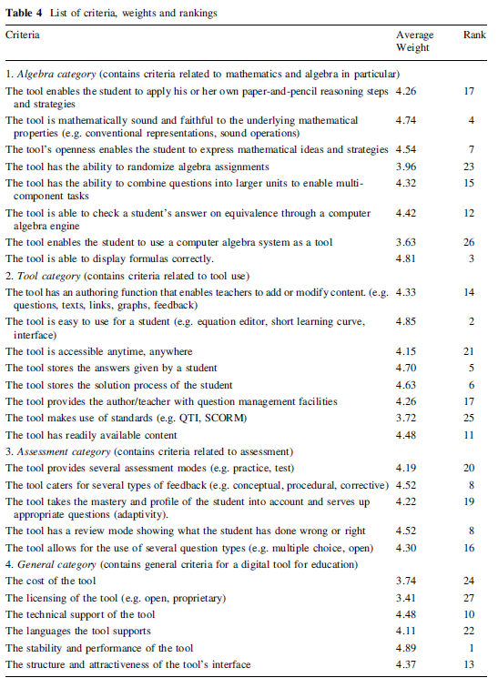
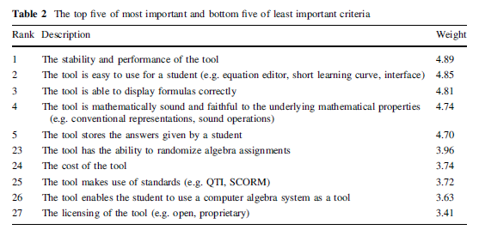
Bokhove, C., & Drijvers, P. (2010). Digital tools for algebra education: criteria and evaluation. International Journal of Computers for Mathematical Learning, 15(1), 45-62.

Slide 11
INTEGRATED DESIGN: DIGITAL BOOKS

Slide 12
International Conference on Mathematics Textbook Research and Development 2014. Strand on e-Textbooks and technology. From Prof. Yerushalmy’s talk

Slide 13
Examples
Apple iBooks
Great looks
Limited interaction
Limited student management options

Slide 14
Overview affordances
Also see beginning of chapter with Kate Mackrell
Two years ago Back’s keynote on e-math project with structured derivations (interactive e-books). E-book architrecture on- and off-line
Activemath-EU, LeActivemath, Mathbridge

Slide 15
Integrated in c-books
The research leading to these results has received funding from the European Union Seventh Framework Programme (FP7/2007-2013) under grant agreement n° 610467 - project “M C Squared”. This publication reflects only the author’s views and Union is not liable for any use that may be made of the information contained therein.

Slide 16
Towards digital textbooks
Digital textbook: theory, examples, explanations
Interactive content (in MC-squared widgets)
Interactive quizzes (formative assessment, feedback)
Integrated workbook

Slide 17
Aims MC-squared
Design and develop a new genre of authorable e-book, which we call 'the c-book' (c for creative)
Creative Mathematical Thinking (CMT)
Initiate a ‘Community of Interest’ (CoI) (Fischer, 2001)
A community of interest consists of several stakeholders from various ‘Communities of Practice’ (Wenger, 1998).
England, Spain, Greece, France
Within these teachers who co-design and use resources for teaching, can contribute to their own professional development (e.g., Jaworski, 2006).
Social Creativity, Boundary objects
UK CoI: learning analytics

Slide 18
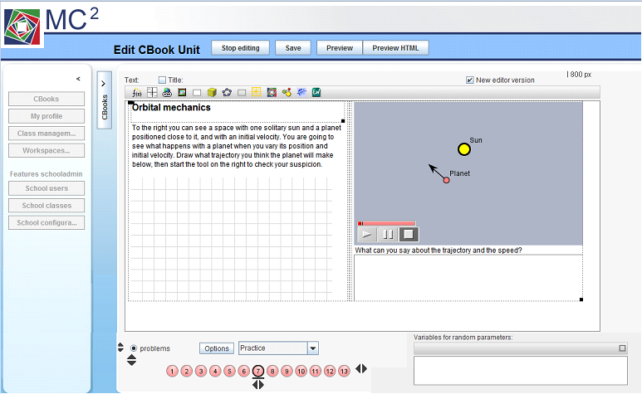

Slide 19
More than sum of the parts
Widgets
Interaction (feedback)
Interoperability
Storing results
Standards
Authorability

Slide 20
Widgets

Slide 22
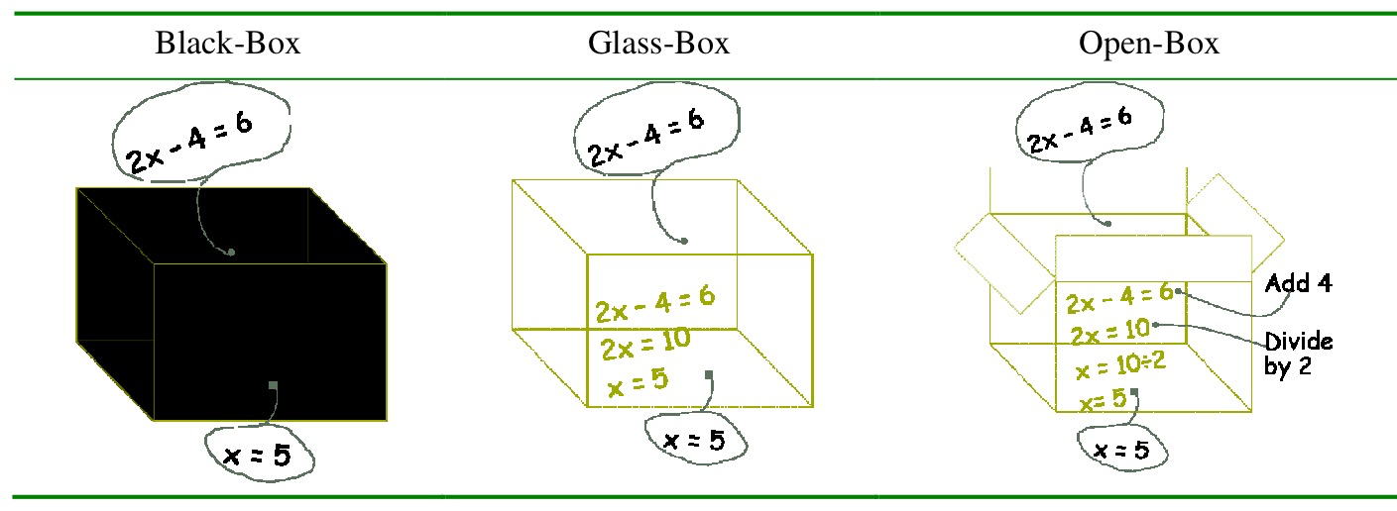
Purpose of technology
e.g. tension learning and doing (e.g. Ainley & Pratt, 2002)
Use to learn, learn to use
Openness
Beeson (1998), open and closed
Bliss & Ogborn (1998), exploratory and expressive
E.g. Buchberger (1990), black box, white box, glass box. Hosein et al. (2008)
Interactivity

Slide 23
Equations: in-between steps, multiple strategies allowed

Slide 24
DEMO WIDGETS
D1
Browse some widgets
http://mc2dme.appspot.com/

Slide 25
More ‘open’ widgets
Visualizing students can “see” abstract concepts
Representations students can make connections
Experiments students can discover mathematics

Slide 26
INTERACTION: FEEDBACK

Slide 27
Essential part formative assessment (Black & William, 1998)
But depends on feedback type(s) e.g. task, process, self-regulation, self (Hattie & Timperley, 2007)

Slide 28
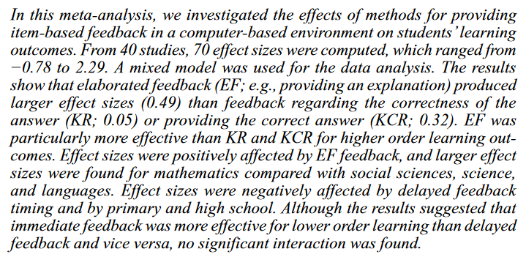
Review: Van Der Kleij et al.

Slide 29
Feedback
Embedded feedback
Authored by the teacher, based on student domain knowledge
Rule-based (e.g. IDEAS feedback)

Slide 30
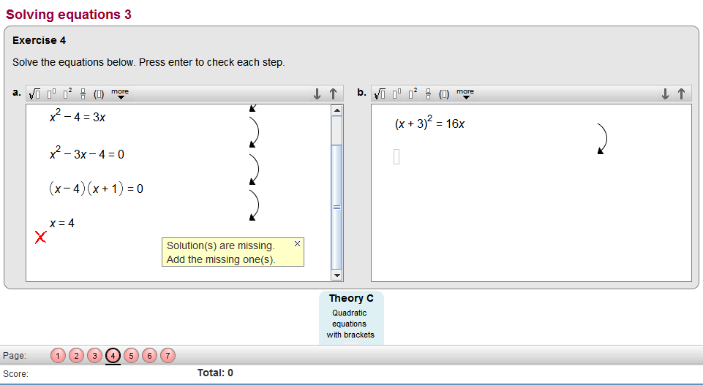
Embedded
D2
Demo 2: from lesson quadratic equations, section 9, page 4.

Slide 31
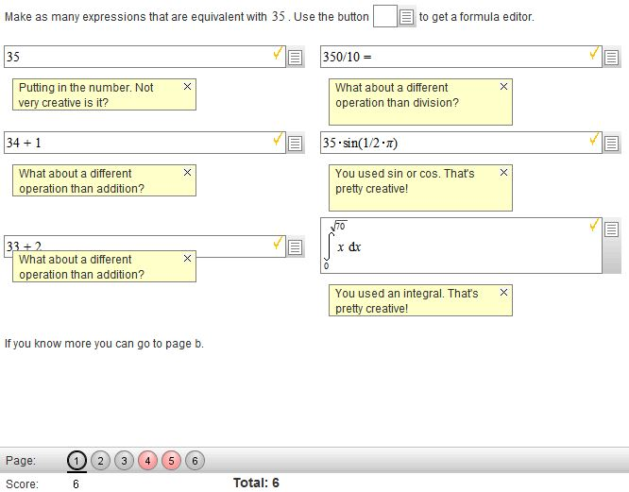
Custom feedback
D3
Demo 3: custom feedback. Number v7, page 1.

Slide 32
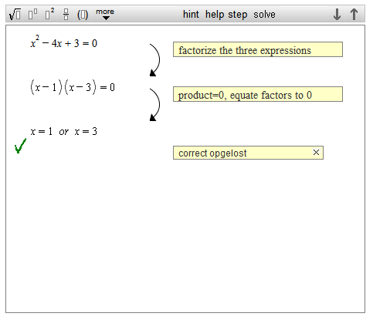
Rule-based feedback
D4
Demo 4: rule-based feedback (webservice by Jeuring et al.)

Slide 33
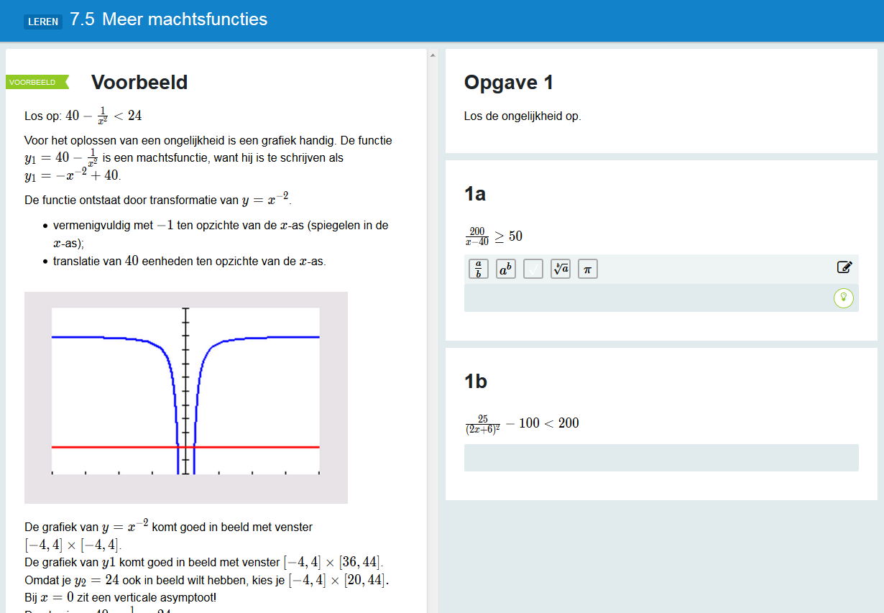
Algebrakit feedback
D5
Martijn Slob
http://demo.algebrakit.nl/demo/mathplus.html#/mathplus
Notes:
Mathspace is another one.

Slide 34
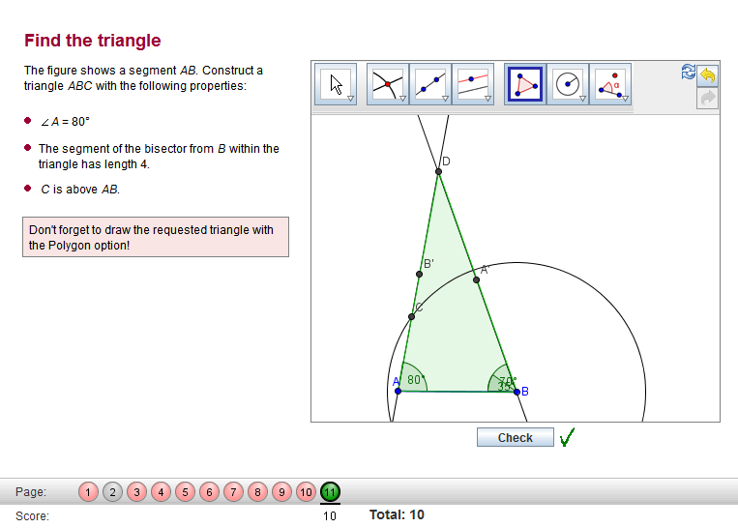
Also geometry checking
D6
NOTE: I’ve added a geometry book to the specific CADGME space

Slide 35
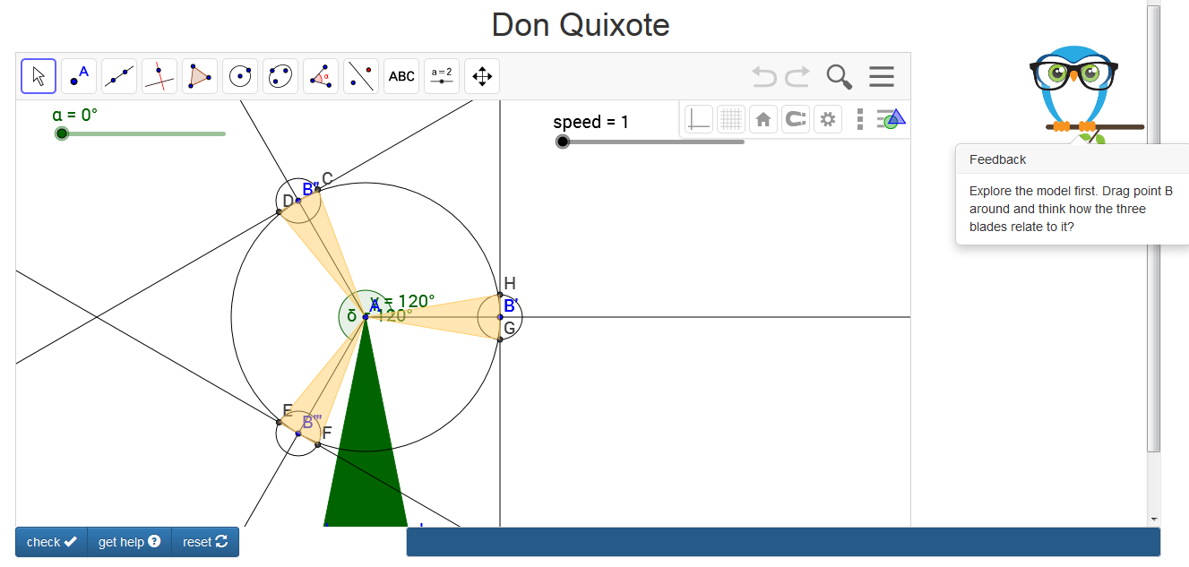
Feedback open task

Slide 36
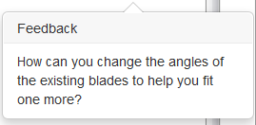
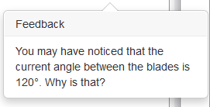
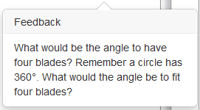

Slide 37
INTEROPERABILITY and standards

Slide 38
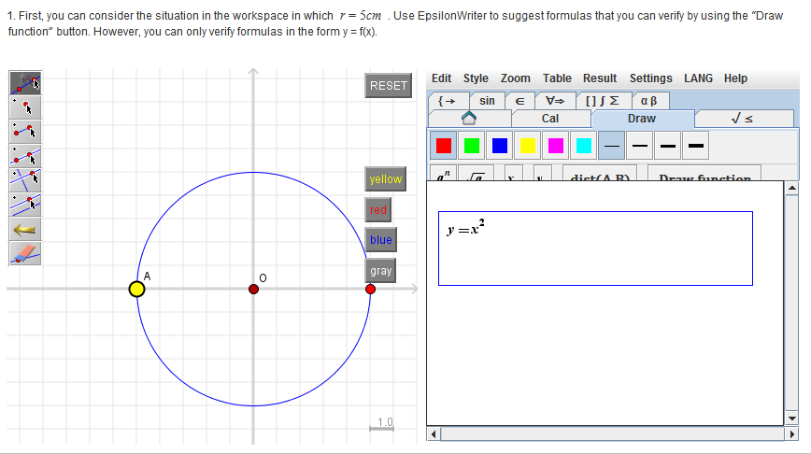
Remains a challenge
Between the ‘management system’ and individual widgets (e.g. SCORM)
Between widgets (e.g. multiple representations)
Here, Cinderella (left) can ‘talk’ with Epsilonwriter (right).

Slide 39
HTML5 player

Slide 40
Storing results

Slide 41
Storing results
Imagine 10 classes with 30 students and numerous tasks: management system
But diversity of data types, ranging from simple checkbox to complexity of geometry widget
Useful for Learning Analytics and studying misconceptions

Slide 42
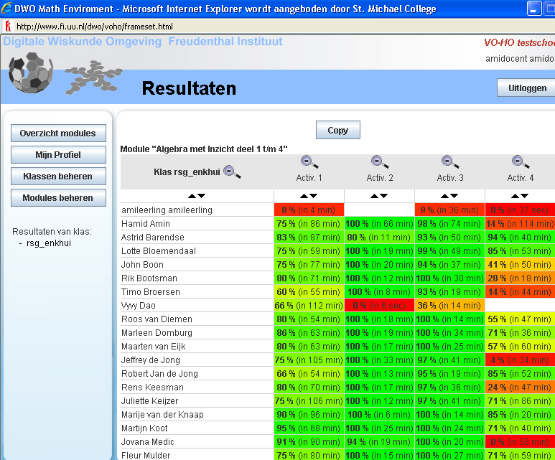
Store student results, and use these as a teacher to study misconceptions and for starting classroom discussions
students

Slide 43
ASPECTS of instructional design: towards AN integrated approach

Slide 44
(i) students learn a lot from what goes wrong, (ii) but students will not always overcome these if no feedback is provided, and (iii) that too much of a dependency on feedback needs to be avoided, as summative assessment typically does not provide feedback. These three challenges are addressed by principles for crises, feedback and fading, respectively.
Bokhove, C. (2016). Chapter in Springer book on variation. Series Mathematics Education in the Digital Era.

Slide 45
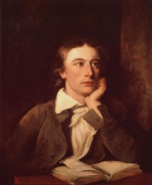
Crisis-tasks
“students learn a lot from what goes wrong”
Cognitive conflict
Desirable difficulties
Productive failure
Disequilibrium
Impasse
“Failure is, in a sense, the highway to success” - Keats

Slide 46
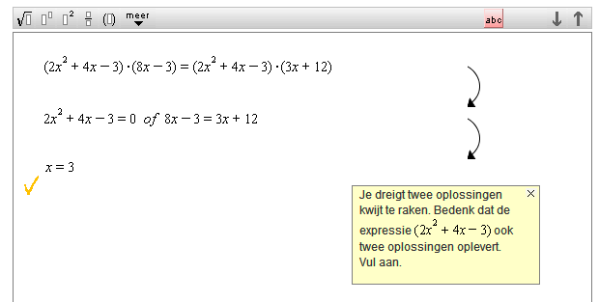
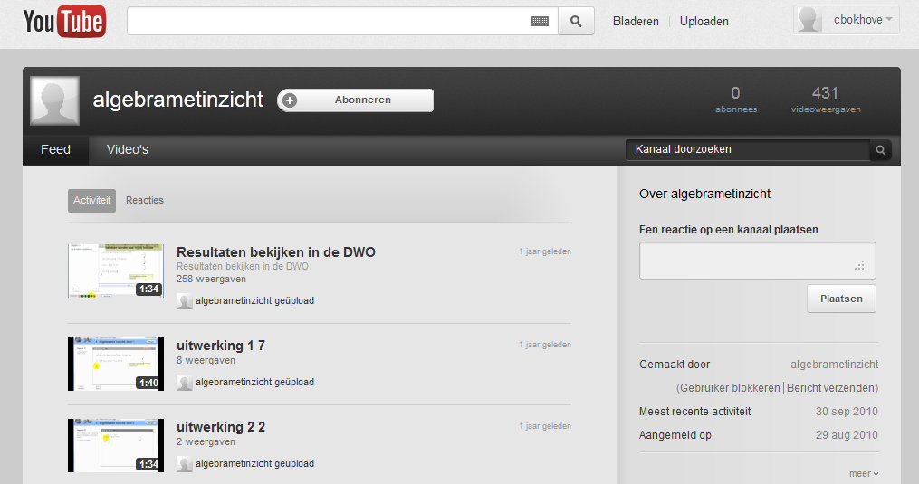
Feedback: overcoming a crisis
“but students will not always overcome these if no feedback is provided”
Screencast clips

Slide 47
Feedback: worked examples and hints
IDEAS feedback, webservice with Jeuring et al

Slide 48
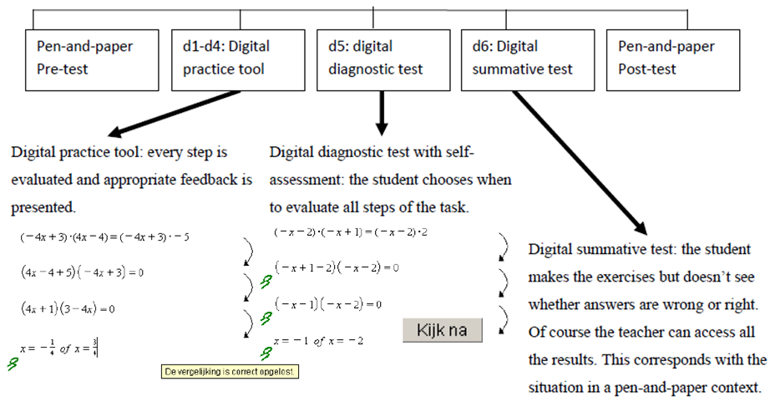
Fading
“too much of a dependency on feedback needs to be avoided”

Slide 49
authorability

Slide 50
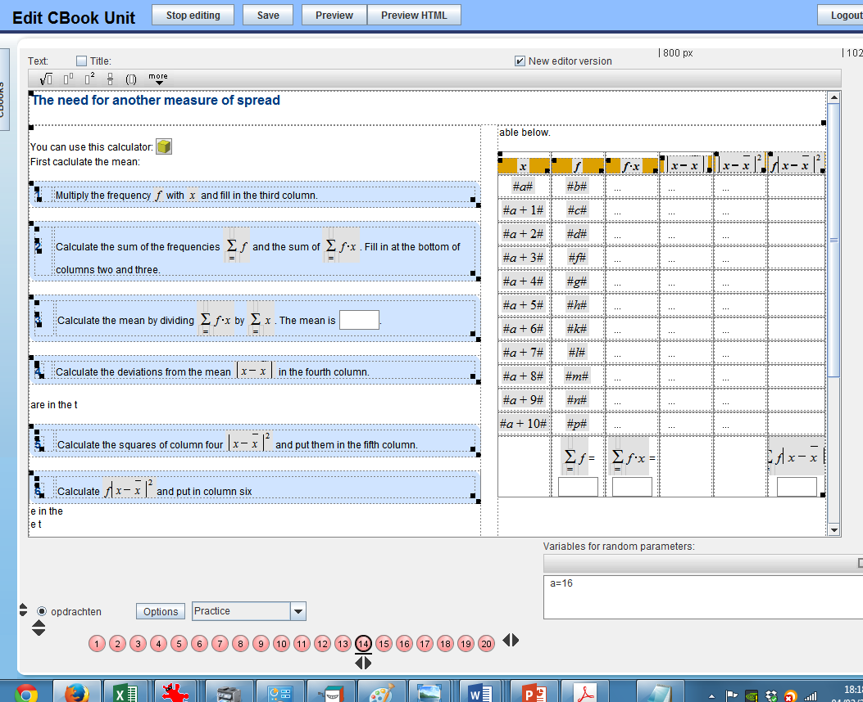
Authorable

Slide 51
To recap: technology-added value of the c-books
Creative and interactive activities made by designers (creative process authoring)
Collaboration within CoI between designers, teachers and computer scientists. Feeds into DA component (see later section)
Interactivity: feedback design
More than one widget factories used
All student data stored
Sum is more than the parts…

Slide 52
enGasia project
Compare geometry education in England, Japan and Hong Kong → some shown now.
two digital resources (electronic books) will be designed. They are then implemented in classrooms in those countries.
The methodology will include a more qualitative approach based on lesson observations and a quasi-experimental element.
Notes:
In international comparisons for mathematics like PISA and TIMSS, Asia outperforms England considerably. For geometry this difference is even greater. With a new maths curriculum coming into play in England in 2014, this project aims to compare geometry education in England, Japan and Hong Kong and to find out how an interactive electronic book could improve geometry teaching. Based on specific characteristics of the participating countries two digital resources (electronic books) will be designed. They are then implemented in classrooms in those countries. The methodology will include a more qualitative approach based on lesson observations and a quasi-experimental element. The results of this will be disseminated in several publications, public workshops and a dedicated weblog. The proposed project will result in a close collaborative network between England, Japan and Hong Kong.

Slide 54
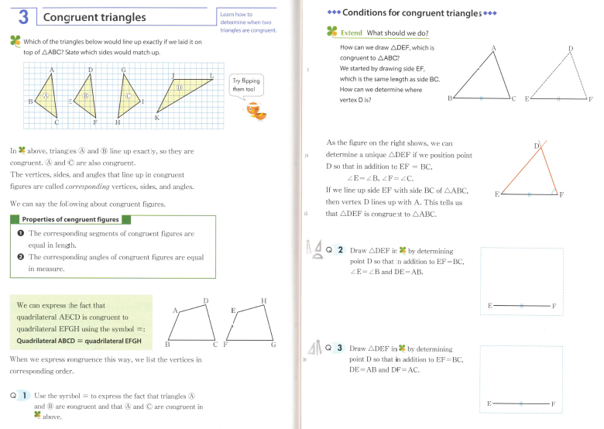
The design process
Multiple widgets
Some work ‘in the backend’ (e.g. feedback)

Slide 55
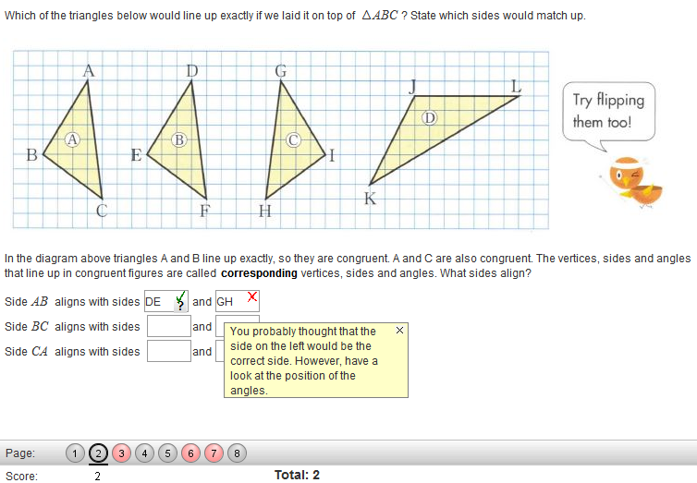
This could be a geogebra widget but perhaps not necessary. More important is feedback.

Slide 56
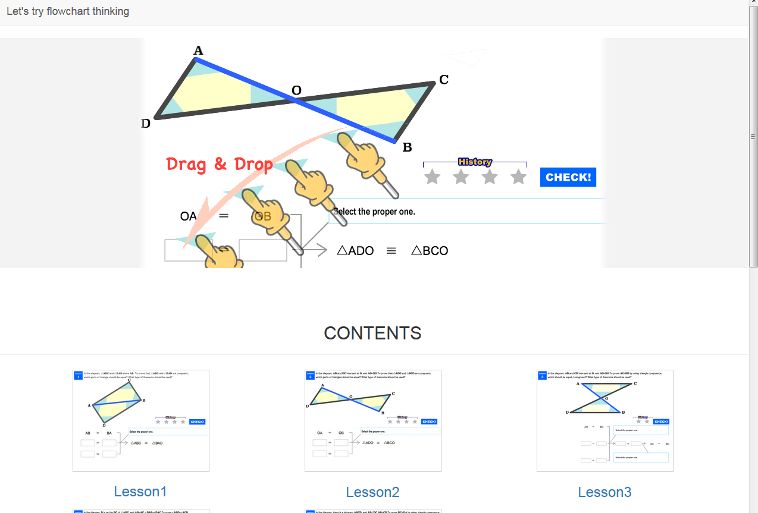
Flowchart
D7
http://www.sun-first.jp/fc_html5d/

Slide 57
Feature | What would not be possible without this feature?
Widgets | If there was a limited range of widgets teachers/authors could not decide on the best pedagogical approach.
Interaction | Digital books would be a ‘one way street’ where content was just presented. Interaction allows student engagement. Feedback can be used for formative purposes
Interoperability | Different widgets could not ‘talk’ to each other. Multiple representations would be possible but not in an integrated manner.
Storing results | Students would need to store results themselves via files or make screenshots. Teachers would need to organise student work themselves.
Standards | Digital books could only be presented in the way a tool would prescribe. By using standards books work in every browser on every platform.
Authorability | Teachers would only be able to use ready made content.

Slide 58
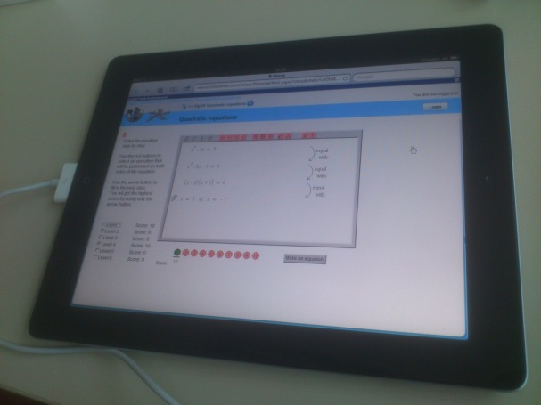
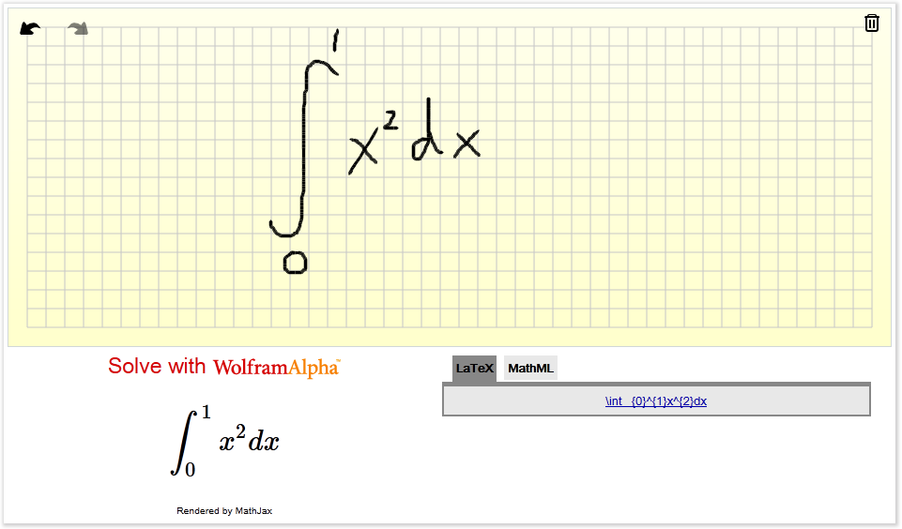
Some other projects
Mental Rotation Skills (building blocks)
Times Tables Rockstars (gamification)
Creativity through constraints
Handwriting and maths input
Classroom work and collaboration e.g. Classkick

Slide 59
Conclusions
Need to look at integrated design: sum more than the parts
This means designers need multiple qualities or need to work in collaborative teams (Communities of Interest)
Need a research pipeline from small-scale qualitative towards rigorous large-scale.
Happy to collaborate. You?

Slide 60
Try out
Browse some c-books.
I can show some of the authoring back-end
Log in as guest all kinds of resources
Log in with cadgme2016_## with ## a number 1 to 50 password ‘pass’ to demo those mentioned in lecture (plus one on complex numbers)
http://mc2dme.appspot.com/
D8

Slide 61
Thank you
Questions/comments?
More information: C.Bokhove@soton.ac.uk
www.bokhove.net
Twitter: @cbokhove

